Slide 1
LegalEase(App For Onboarding Legal Services)
CSE7101- Capstone Project
Review-3
Batch Number: CSE_160
Under the Supervision of,
Mr. Thatimakula Saikumar – Assistant Professor
Ms. Saiqa Khan - Assistant Professor
School of Computer Science and Engineering
Presidency University
Roll Number | Student Name
20221CSE0090 20221CSE0195 20221CSE0225 | Vishnu. P Vasista. S Dhanush. A
Name of the Program: Computer Science and Engineering
Name of the HoD: Dr.Asif Mohammed , Dr.Blessed Prince
Name of the Program Project Coordinator: Dr.Jayavadivel Ravi , Mr.Muthuraju V
Name of the School Project Coordinators: Dr. Sampath A K , Dr. Geetha A

Slide 2
Content
Github link
Abstract
Literature Survey
Objectives
Algorithms
Proposed method & Feasibility study
User Flow Diagram
Modules
Timeline of the Project
References

Slide 3
Problem Statement Number: PSCS-39
Git-hub Link : https://github.com/vishnu090705/Onboarding-legal-service-providers.git
Category : Software
Abstract :
This project develops a secure Android application for onboarding Legal Service Provider to ensure authenticity and trust. Existing portals fail to provide simplified, accessible, and timely updates, resulting in missed opportunities.
An incentive-based gamification model encourages professional participation, while citizens gain transparent access to verified legal services through a reliable digital marketplace.
The expected outcome is a transparent, secure, and user-friendly eMarketplace that enhances citizen trust, improves access to legal services, and ensures better engagement of professionals. The project also offers real-world exposure to full-stack mobile development, authentication systems, and incentive-based platform design.

Slide 4
Literature Survey
[10] Nyaya Shastra: E-Platform for Legal Providers," IJARSCT, 2024
Link: https://ijarsct.co.in/Paper25646.pdf
[12] Karnale, P.R., Chavan, S.R., Chougale, A.B., Patil, A.A., Jamadar, S.S. (2023), "Incentives based Design for onboarding Legal Service Providers for Extending Legal Services.“
Link: https://www.scribd.com/document/711640084/Incentives-based-Design-for-onboarding-Legal-Service-Providers-for-extending-Legal-Services-to-Citizens-in-India-1
[15]LEGAL SAHYOG HUB: JETIR2406832, "Incentives Based Design For Onboarding Legal Service Providers.”
Link: https://www.jetir.org/view?paper=JETIR2406832
[18]Legal Bharat Incentive, Legalbharat
Link : https://www.scribd.com/document/875148548/Legal-Bharat-Incentive

Slide 5
Objectives
Develop a secure Android application that enables Legal Service Providers (LSPs) such as advocates, notaries, and mediators to onboard digitally with proper authentication.
Ensure transparency and accessibility by providing real-time updates on service requests, provider availability, and feedback.
Design and implement an incentive-based system (badges, rewards, rankings) that motivates legal professionals to actively participate and maintain service quality.
Provide citizens with a user-friendly interface to search, filter, and connect with verified legal service providers, while allowing admins to monitor onboarding and approvals.

Slide 6
Algorithms
Resource Allocation (Avoid Double-Booking)
Reliable booking engine—no overlapping bookings, respect working hours, support recurring slots.
Concepts used:
Array List / Hash Maps
How it works:
Maintain an interval tree (or segment tree) of booked slots per provider.
To check availability, search for any overlapping intervals. Insert/delete in log time.
Why We Use:
Prevents double-booking of providers
Ensures trust - citizens won’t see providers cancel due to conflicts.

Slide 7
Proposed method & Feasibility study
Proposed Method:
The proposed solution is the “LegalEase" Progressive App. Its innovation lies in its integrated, accessible, and user-centric design:
Incentive-Based Engagement System Gamification features such as badges, points, and rankings to motivate professionals.
Cloud-Backed Storage and APIsFirebase / AWS S3 for secure document and image storage.
Technical Feasibility: The system can be implemented using widely available technologies like Android Studio (Java) for mobile development, Firebase/AWS for secure storage.
Economic Feasibility: Deployment on cloud services can be scaled as needed, ensuring cost-effectiveness for prototype and real-world usage.

Slide 8
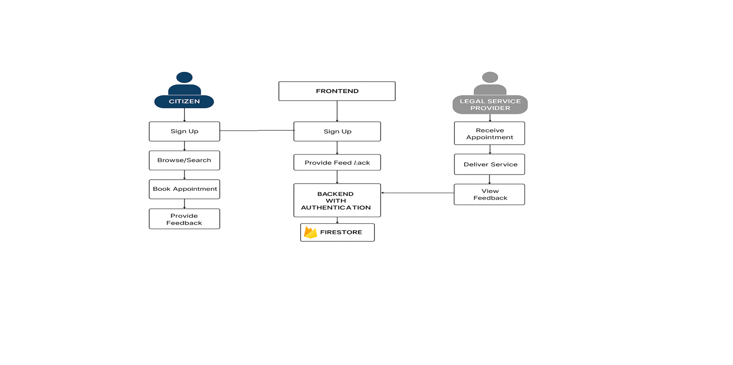
User Flow Diagram

Slide 9
User Flow Diagram continue….
The User Flow Diagram illustrates the interaction between different stakeholders of the E-Marketplace for Legal Services platform. It explains how both citizens (users) and legal service providers (lawyers/advocates) navigate through the application.
1. Citizen (User) Flow:
Sign up or log in to the application.
Search and browse available legal services.
Select a legal service provider and book an appointment.
Receive confirmation and interact with the service provider.
Provide feedback after the service is delivered.
2. Legal Service Provider Flow:
Register and create a professional profile.
List services offered and set availability.
Receive and manage appointment requests from citizens.
Deliver the service (consultation/advice).
Collect feedback to improve visibility and reputation.

Slide 10
User Flow Diagram continue…….
Frontend(Mobile Application):
Operating System: Android 7.0 (Nougat) or higher
Development Environment:
  Android Studio (latest stable version, e.g., Android Studio Iguana or later)
  Java JDK 8 or above
  Gradle (comes with Android Studio)
Programming Languages:
  Java for app logic
  XML for UI design
Backend (Cloud Services):
Firebase Authentication (for secure user login/signup)
Firebase Firestore Database (for storing user profiles, lawyer details, and appointment records)
Firebase Cloud Functions (optional, future scope) for business logic like notifications, verification
Firebase Cloud Messaging (optional) for push notifications

Slide 11
User Flow Diagram continue…….
Libraries and APIs
Google Firebase SDK (Authentication + Firestore)
AndroidX libraries (AppCompat, Material Components, ConstraintLayout, RecyclerView, etc.)
Play Services (Google APIs) if you later add location-based lawyer search
Key Components:
Authentication Service: Manages user logins.
Cloud Hosting: The entire application is deployed on a cloud provider for reliability and scalability.

Slide 12
Modules
User Authentication Module: Handles registration and login of Legal Service Providers (LSPs), citizens, and admins.
Incentive & Gamification Module : Provides rewards such as badges, points, certificates, and higher visibility for verified LSPs.
Citizen Service Access Module : Enables citizens to search, filter, and view verified LSP profiles.
Cloud Storage & API Module : Uses Firebase Storage / AWS S3 to store documents.

Slide 13
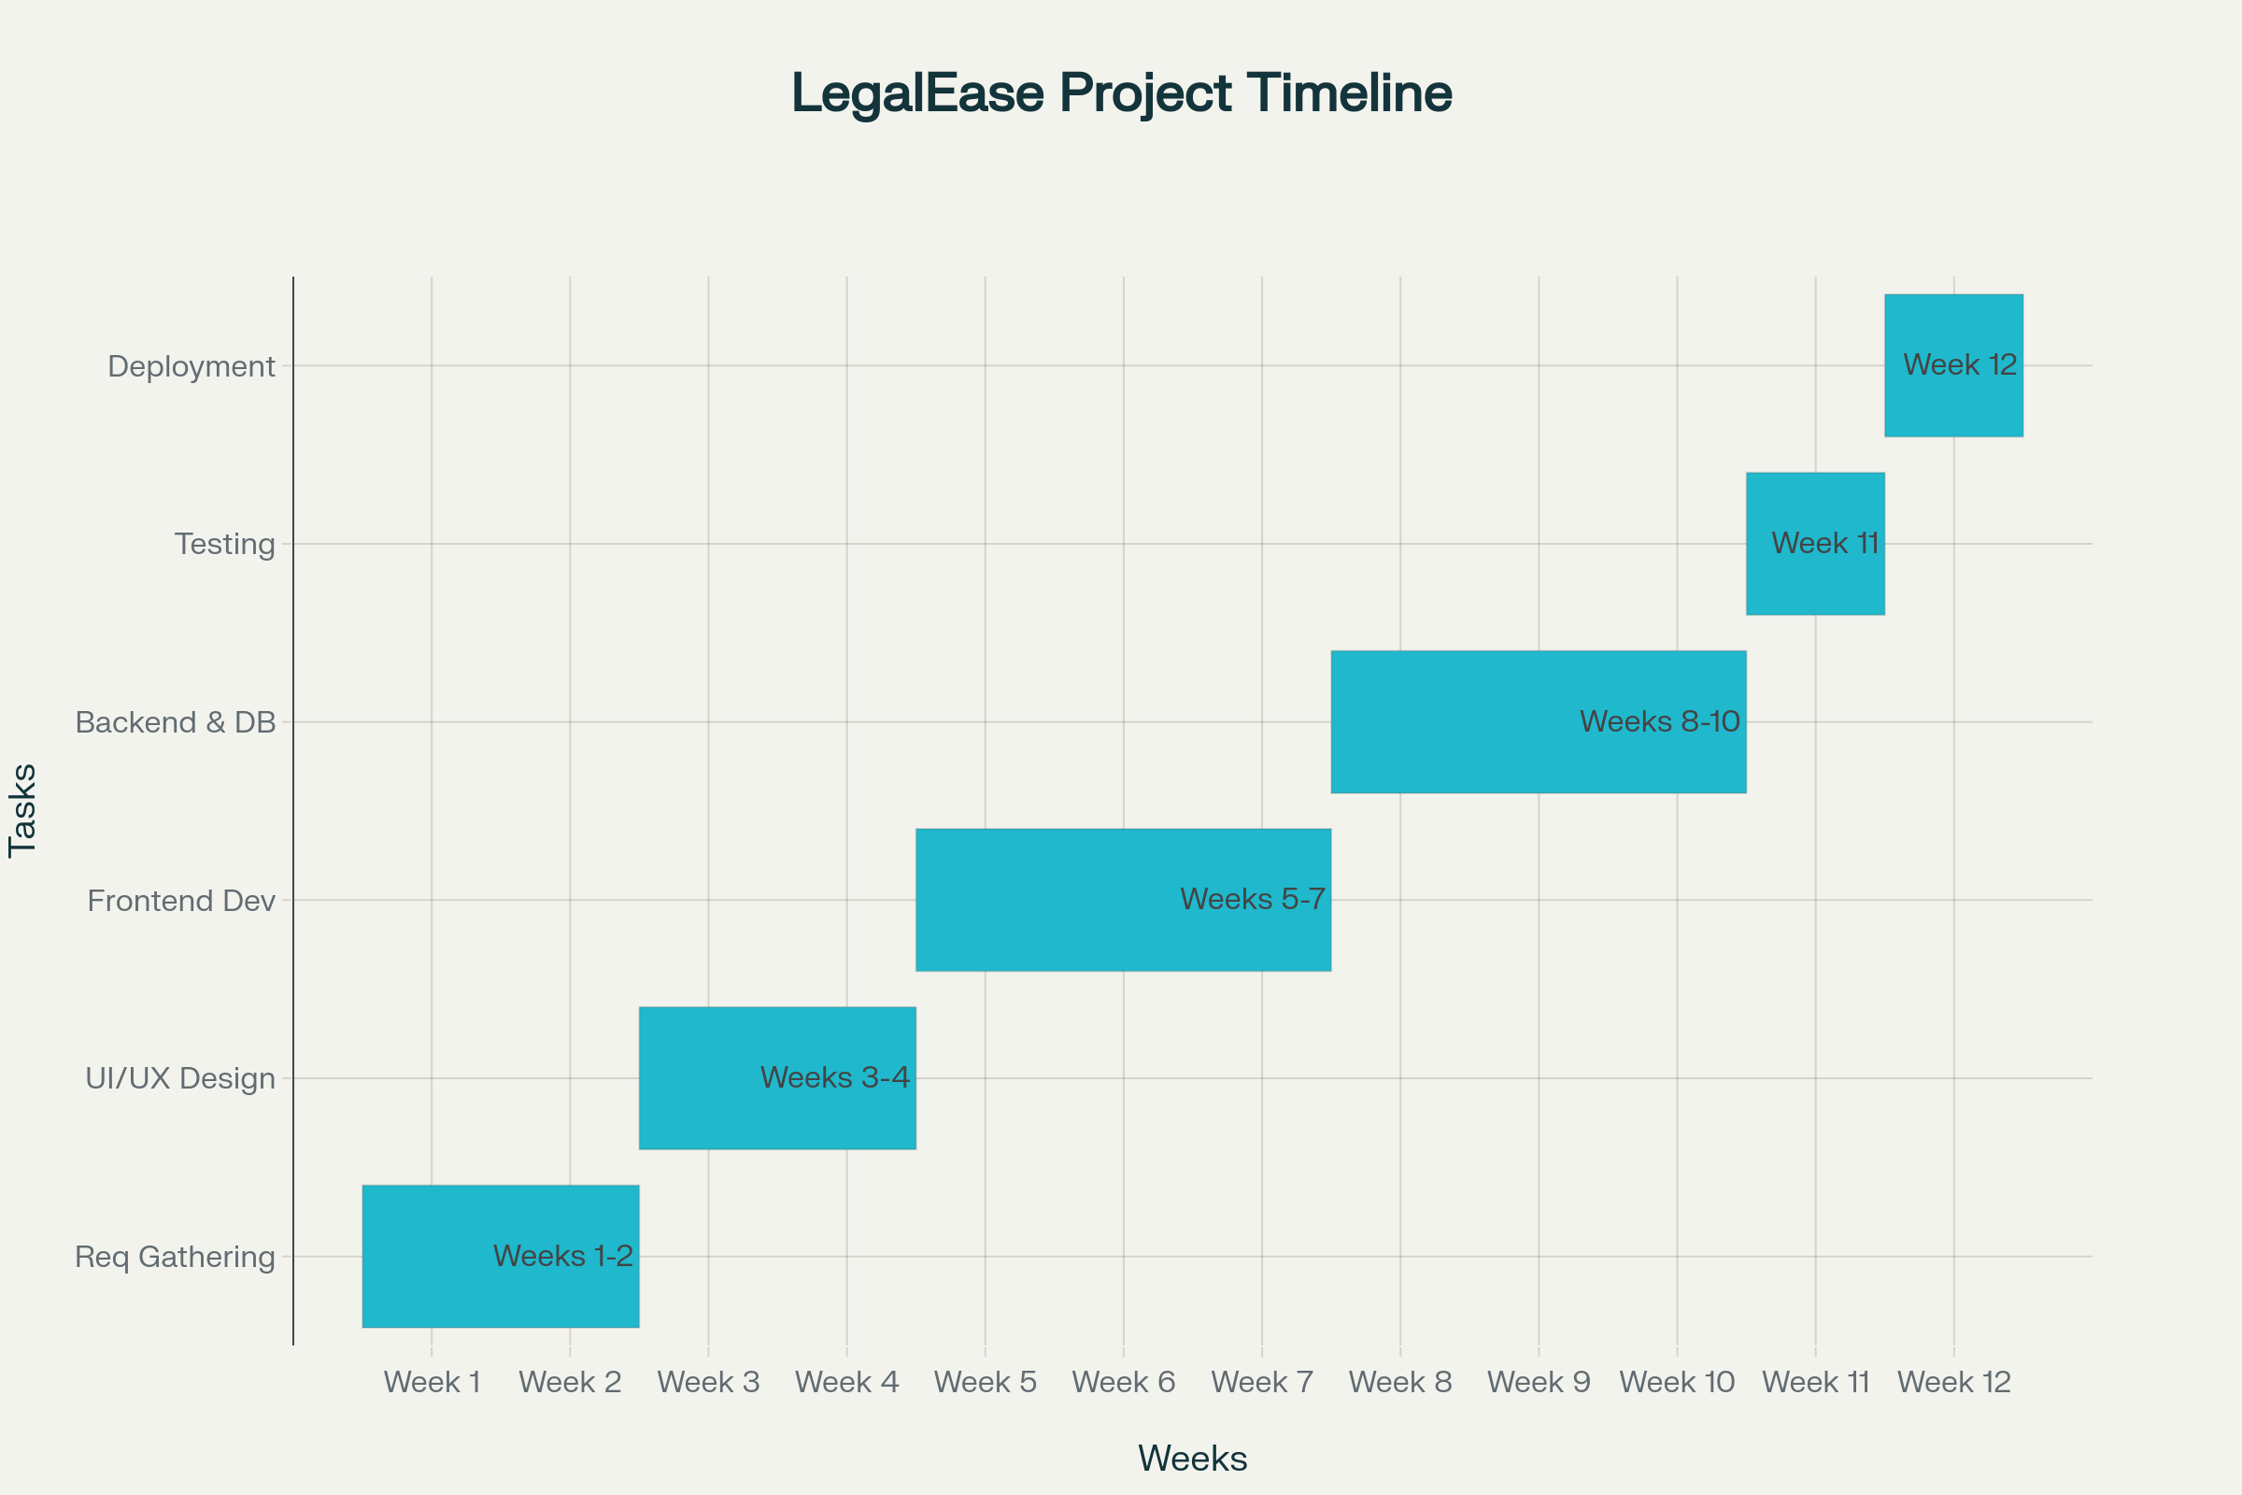
Timeline

Slide 14
References
[1]. [Sharetribe], "How to build a marketplace for legal services," 2023.sharetribe
[2]. Itexus, "Legal Marketplace Development: Guide," 2023.itexus
[3]. "LegalTech in India – Role of Technology and Legal Education," Taxmann, 2025.taxmann
[4]. Infosys, "How a Digital Transformation Enhances the Extended Legal ...," Infosys.com, 2024.infosys
[5]. "Alternative legal service providers muscle in," Law.asia, 2025.
[6]. "Top 11 ODR Service Providers in India," Online Legal India, 2025.onlinelegalindia
[7]. Indian Journal of Law and Technology (IJLT), Vol. 20, Issue 1 (2022).
[8]."Impact of Digital Legal Services on Traditional Law Practice in India," ICISIT,2024.iciset
[9]. "Startups as disruptors of legal tech in India," Daksh, 2020.dakshindia
[10]. "Nyaya Shastra: E-Platform for Legal Providers," IJARSCT, 2024.ijarsct
[11]. Legal Kart, "The Rise of Online Lawyer Consultation," LegalKart.com, 2025.

Slide 15
References continue…
[12]. Karnale, P.R., Chavan, S.R., Chougale, A.B., Patil, A.A., Jamadar, S.S. (2023), "Incentives based Design for onboarding Legal Service Providers in India," IJSREM.scribd
[13]. "Legal Tech Startups in India," PrivateCircle, 2025.
[14]. "Online Dispute Resolution Service Providers in India," 2025.
[15]. LEGAL SAHYOG HUB: JETIR2406832, "Incentives Based Design For Onboarding
Legal Service Providers," JETIR.org.jetir
[16]. "Exploring the Significance of Onboarding Process in Higher Education," JETIR.org, 2023.jetir
[17]. Phenom, "The Importance of Onboarding and How to Get It Right," 2025.phenom
[18]. Legal Bharat Incentive, Legalbharat, 2025.scribd
[19]. LawRato, Platform Overview.privatecircle
[20]. Legal Service India, Platform Overview.scribd
[21]. Gupta, S., "Commercial Disputes and Technology," 2021.taxmann
[22]. Legal Connect, Platform Overview.scribd

Slide 16
Conclusion
This application successfully bridges the gap between citizens and legal service providers.
Reviews and feedback ensure transparency and trust in the system.
Incentive-based design motivates provider to deliver quality service.
This application lays a strong foundation for scalable and reliable legal marketplace.
Future Work :
Implement rating & review analytics (average rating, top providers).
Add role based access control(citizen, provider).
Add push notifications using Firebase Cloud Messaging.

Slide 17


